Slide 1
LGBMRegressor (LightGBM)
Fast and Efficient Gradient Boosting for Regression Tasks

Slide 2
What is LightGBM?
LightGBM is a high-performance gradient boosting framework developed by Microsoft.
It is optimized for speed, memory efficiency, and accuracy, especially on large datasets. LightGBM uses histogram-based learning and grows trees leaf-wise.

Slide 3
How LGBMRegressor Works
• Builds trees using a leaf-wise strategy (instead of level-wise).
• Focuses on leaves with the highest loss reduction.
• Creates deeper trees that lead to better accuracy.
• Supports parallel and GPU learning for efficiency.

Slide 4
Important Parameters
• n_estimators: Number of boosting rounds.
• learning_rate: Step size for each tree.
• max_depth: Maximum depth of trees.
• num_leaves: Number of leaves per tree.
• random_state: For reproducibility.
• min_data_in_leaf: Minimum samples in one leaf.

Slide 5
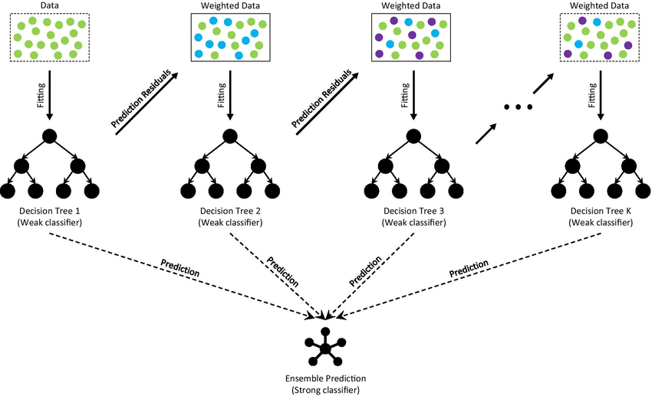
How LGBoost Works

Slide 6
Advantages and Use Cases
✓ Faster training than traditional gradient boosting.
✓ Lower memory usage.
✓ High accuracy on large datasets.
Use cases: Finance, eCommerce, Recommendation Systems, Healthcare Analytics.

